Slide 1
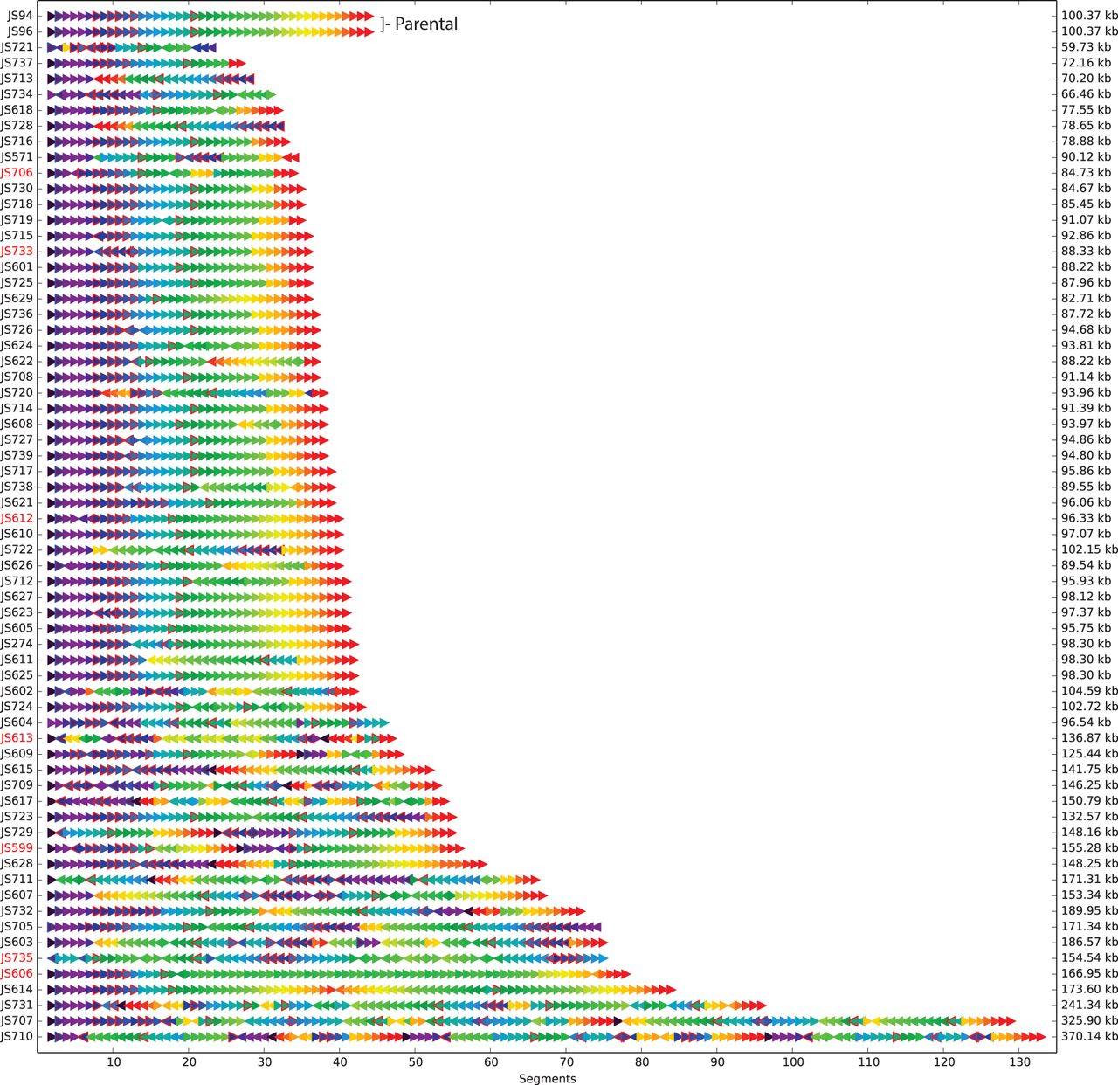

Rearrangements were observed in synIXR SCRaMbLE strains.
Yue Shen et al. Genome Res. 2016;26:36-49
© 2016 Shen et al.; Published by Cold Spring Harbor Laboratory Press
Notes:
Rearrangements were observed in synIXR SCRaMbLE strains. Each SCRaMbLE strain is represented as a sequence of arrows. The color of each arrow indicates the segment number in the parental chromosome, and the direction of the arrow represents the orientation (SCRaMbLEgram visualization). A red border denotes a segment containing an essential gene. The names of slow growth strains are indicated in red text.

